Slide 1

LIBGRAM
A library manager for small village libraries
B4G1
Yeshwant Shetgaonkar 2661
Yash Gaonkar 2660
2026-2027

Slide 2
INTRODUCTION
This lightweight, intuitive software transitions small village libraries directly from manual, paper-based record keeping to a modern digital system. By replacing physical registers, paper logbooks, and manual filing with an easy-to-use digital work flow, local libraries can effortlessly catalogue books, manage member profiles, and track daily loan. All this without requiring complex training or expensive hardware.
Presented Yeshwant & Yash
LibGram
2026-2027

Slide 3
COMPETITOR ANALYSIS
Competitor | Main Features | Possible Weakness / Opportunity
Evergreen | Library automation, cataloguing, circulation, members | Can be complex for small local libraries
LibSys (central library) | Cataloguing, circulation, reports, member management | More suited to larger library networks
SLiMS | Library management, OPAC, circulation, reports | Can be costly for small libraries
eGranthalaya | Open-source library management, cataloguing, borrowing | Requires technical setup/customization
MyLibrary | Library automation, cataloguing, circulation, reports | Mainly designed for institutional/government libraries
 | Book/member management, issue-return tracking | Basic compared with modern cloud systems

Slide 4
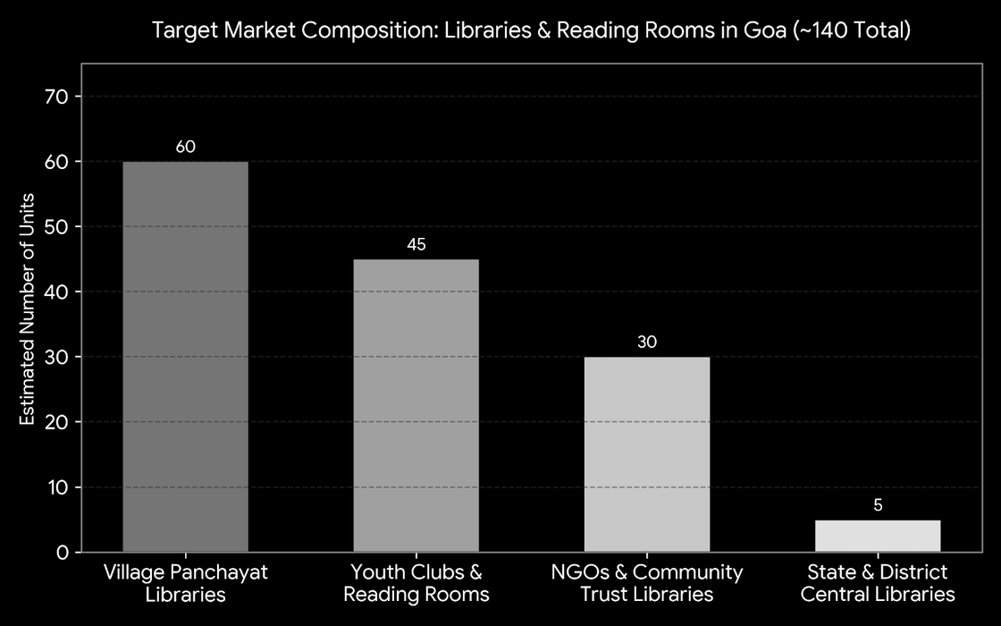
MARKET ANALYSIS
Entire India
India has over 70,000+ rural public libraries and Gram Panchayat reading rooms, alongside thousands of community-run, NGO-supported, and trust-managed libraries across rural states
Goa’s Market alone
Goa has over 140+ registered village, club, and NGO-run libraries across its 12 Talukas (such as Pernem, Sattari, Bicholim, and Salcete), anchored by the Directorate of Higher Education / Art & Culture network.
LibGram

Slide 5
TECHNOLOGY SELECTION
Java & Swing: Meets OOP course requirements and supports desktop applications
Offline Access: Runs without a browser or internet connection.
CSV File Storage: Simple, easy to inspect, and convenient for backups.
Limitations: Limited multi-computer data sharing; Java 21 runtime/bundle required.
LibGram

Slide 6
REVENUE MODEL
Provide platform to individual collectors to showcase, lend and keep track of their books.
Lender can also charge the borrower a small base amount per book and/or opt for delay charges incase the books aren’t returned in time.
Village libraries charge a small fee per day per book delayed.
Libraries also need the base software + an optional online database incase the local device storage ran in to issues.
Providing a online platform to both individuals and libraries to handle financial transactions will earn us a platform fee per transaction.
Providing a online backup database could be a premium service.
base establishment cost for village libraries.
Presented by Yeshwant & Yash
Lib-Gram

Slide 7
THANK YOU
Presented by Yeshwant & Yash
LibGram
2026-2027

